Slide 1
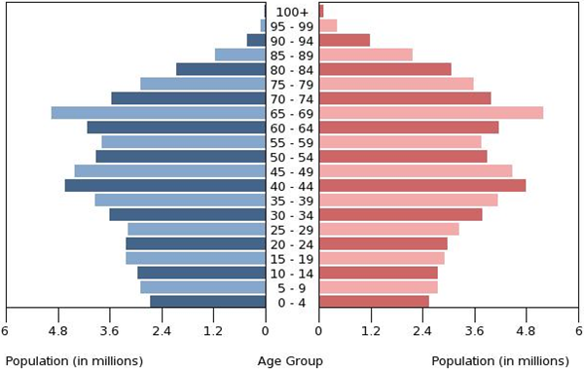

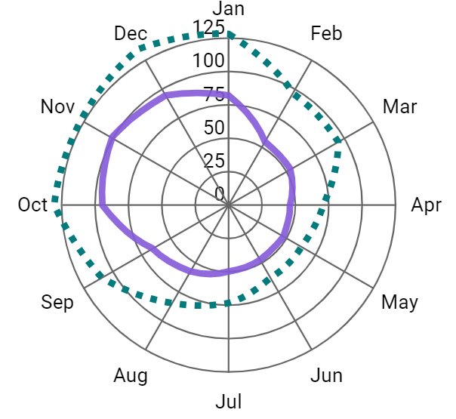
Problem solving with graphical representations of data
Task A: Problems with different representations of data
1) The graph shows data about the population of Japan in 2016.
male
female
Tick the statements below which are true, based on this data.
There are significantly more men than women.
The biggest population group is school-age children.
There are not many people over 90 years old.
The number of babies born has gone down over time.
2) The graph shows data from the Met Office about the average rainfall (mm) per month in two towns, from 1941 to 2022.
a) Which town tends to get more rainfall?
b) Which town tends to have its wettest month of the year in November?
c) Which tends to be wetter: Eastbourne in February or Stornoway in July?
Stornoway
Eastbourne
Eastbourne
Stornoway in July
Stornoway

Slide 2
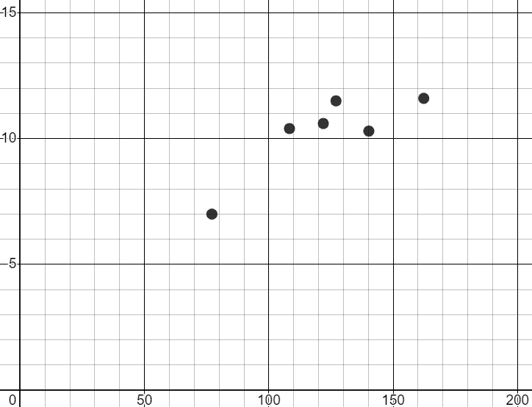
Problem solving with graphical representations of data
Task B: Responding to additional data
1) Sofia investigates whether there is a connection between sunshine and temperature. She collects weather data in Bradford for each March from 2017 to 2022 and plots a scatter graph.
She concludes that there is no connection between the variables.
mean of daily maximum temperature (℃)
total sunshine duration (hours)
a) The table shows data from 2012 to 2016. Plot the points on the scatter graph.
sunshine (hours) | 162 | 67 | 124 | 105 | 106
temperature (℃) | 13 | 4 | 11 | 9.5 | 9
b) How might these additional points affect Sofia’s conclusion?
It looks more likely that there could be a connection between the variables.
Months with more sunshine tend to have higher temperatures.
More data could it make even clearer whether there is a connection.
Mathematics in Education and Industry
v2.2

